Slide 1

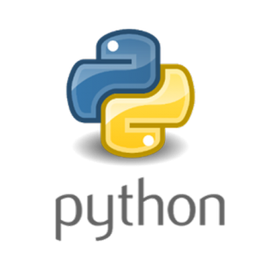

Slide 2
Overview
Introduction
History of Python
Advantages of Python
Software Installation
Basic Syntax
Basic programs using python
Strings in Python
Lists & Tuples
Dictionary
Oops Concepts in Python
Practical programs

Slide 3
What is Python???
Multi – purpose (Web, GUI, Scripting, etc...)
High level
Free & open source
Extensible (Add new modules like C/C++/Java…)
Python is case sensitive language
Machine Learning
AI
Game Development
Web Site
Web Application
IOT

Slide 4
History of Python???
Created by Guido Van Rossum in 1989
Python 1.0 released in 1994
Python 2.0 released in 2000
Python 3.0 released in 2008
Python 2.7 is the recommended version
ABC And C and C++
programming language is said to be the predecessor of Python language

Slide 5
Advantages of Python???
Powerful & fast
Clear & readable syntax
Runs immediately
Less coding required
Extensive standard libraries
Portable

Slide 6
Who uses Python???
Google
PBS
NASA
Library of Congress
…the list goes on…

Slide 7
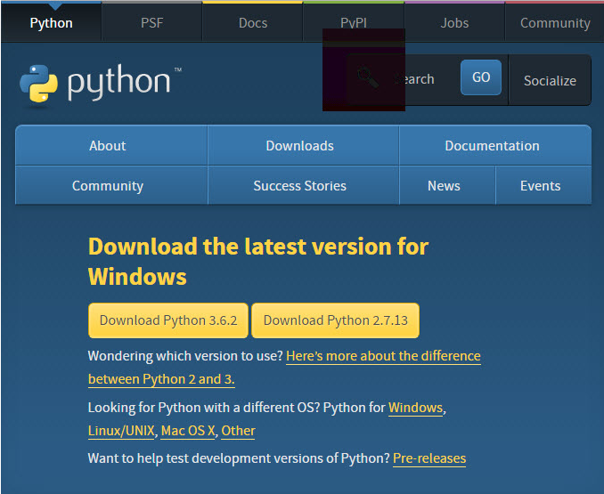
Software Installation
Python version – 3.6.2
Click https://www.python.org/downloads/

Slide 8
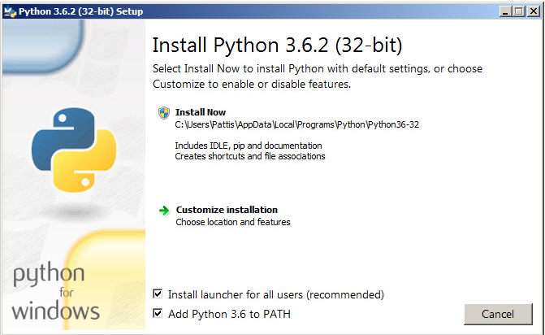
Software Installation cont...
Double-click the icon labeling the file python-3.6.2.exe.
Click Run.

Slide 9
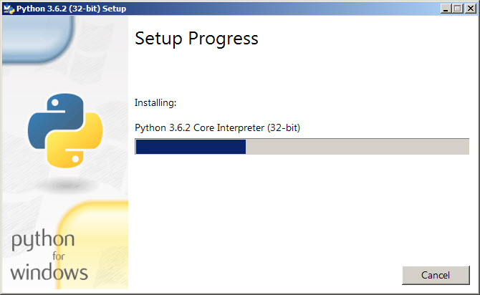
Software Installation cont...
After click install now the below pop window will open

Slide 10
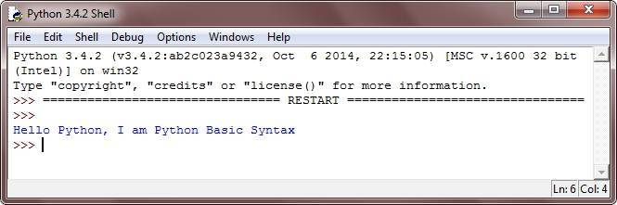
Basic Syntax
# Python Basic Syntax - Example Program
print("Hello Python, I am Python Basic Syntax");

Slide 11
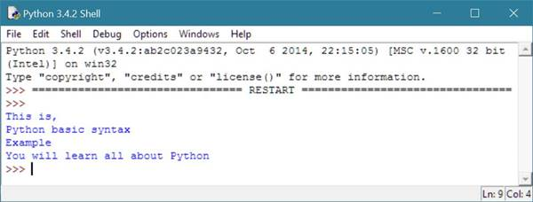
Basic Syntax
print("This is,\nPython basic syntax\nExample");
print("You will learn all about Python");

Slide 12
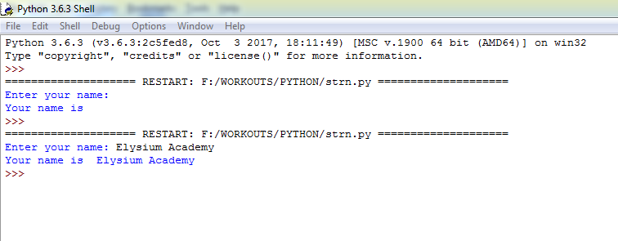
Read User Input from Keyboard in Python
strn = input("Enter your name: ")
print("You name is ", strn);

Slide 13
Comments
Comments in Python are used by the developer to provide,
give or write some information about some line of code in Python program.
Types of Comment in Python
There are two types of comment available in Python.
Single line comment
Multi line comment

Slide 14
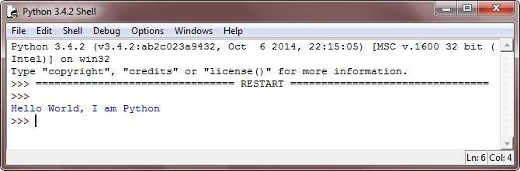
Single line comment
Single line comments are the comments that can be written in only one line with the help of commenting code that is used to write at the beginning of comment.
Syntax:
# Python Basic Syntax - Example Program
# We are comments
print("Hello World, I am Python"); # i am also comment

Slide 15
Multiline Comment
Comments that can be written in more than one line with the help of single commenting code is known as multiline comment in Python.
Multiline starting commenting code is ''' and ending with same, that is '''.
Syntax:
''' This
is
multiline
comment '''

Slide 16
Identifier
Identifiers in Python, is simply a name given to identify the variable, function module, class, or any other object in the Python program.
Rules to Write Identifiers in Python
In Python, you can name an identifier with:
a letter (a-z or A-Z)
or underscore (_) character
followed by more letters, digits (0-9) or underscore

Slide 17
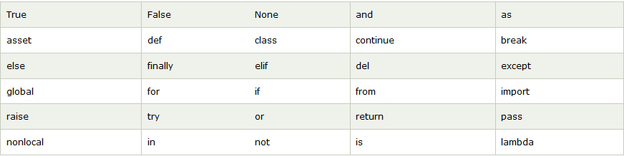
Keywords
Keywords are reserved words, having their special meaning.
You can not use any of the python keyword as identifier.
Keywords in python used to perform some particular task.

Slide 18
Data Types
Basically data type represents the type of value and determines how the value can be used in a python program.
Five standard data types
Numbers
Strings
List
Tuple
Dictionary
Set

Slide 19
Syntax of the data types
Examples of number data type:
i = 10
f = 23.43
total = 987
Examples of string data type:
str = “Hello World, I am Python Data Types”

Slide 20
Examples of list data type:
A list in Python is used to store the sequence of various types of
data.Python lists are mutable type its mean we can modify
its element after it created.
list = [10, 20, 30, 'hi', 'hello', 43.23, 432.42, 'python']
Examples of tuple data type:
Python Tuple is used to store the sequence of
immutable Python objects.
The tuple is similar to lists since the value of the items
stored in the list can be changed, whereas the tuple is
immutable, and the value of the items stored in the tuple
cannot be changed.
tuple = (10, 20, 30, 'hi', 'hello', 43.23, 432.42, 'python')
A Python set is the collection of the unordered items.
Each element in the set must be unique, immutable, and
the sets remove the duplicate elements. Sets are mutable which means we can modify it after its creation.
Unlike other collections in Python, there is no index attached to the elements of the set, i.e.,
we cannot directly access any element of the set by the index. However, we can print them all together,
or we can get the list of elements by looping through the set.

Slide 21
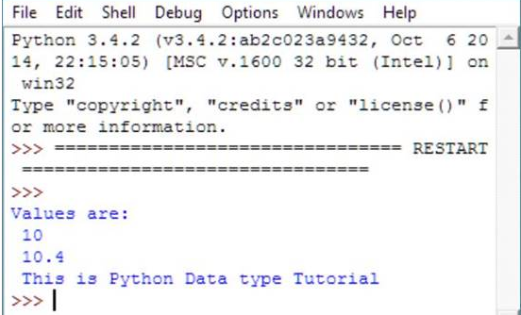
Examples of dictionary data type:
Python Dictionary is used to store the data in a key-value pair format. The dictionary is the data type in Python, which can simulate the real-life data arrangement where some specific value exists for some particular key. It is the mutable data-structure.
dict = {'number': 10, 'code': 20, 'name': 'python'}
Data type Examples:
# Python Data Type Example
float_var = 10;
int_var = 10.40;
str_var = "This is Python Data type Tutorial";
print("Values are:\n",int_var,"\n",float_var,"\n",str_var);

Slide 22
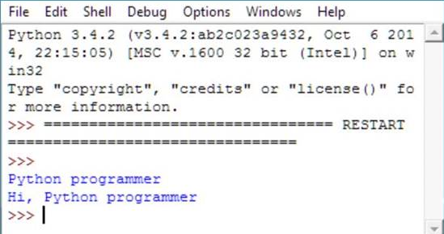
Variables
Variables are the reserved memory locations to store the values. It means that, whenever you are creating a variable you are reserving some space in the memory for that variable.
Create a Variable in Python
variable_name = “Python programmer";
print("Hi, ",variable_name);

Slide 23
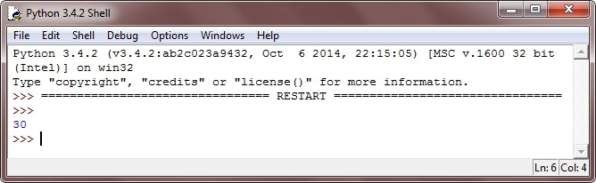
Variable Examples
assigning values to variables in Python
num1=10
num2=20
print(num1)
print(“No”,num1)
print(num2)
print(“No”,num2)
sum=num1+num2
print(sum)

Slide 24
Operators
Operators are used to perform mathematical and logical operations.
There are the following types of operators available in Python:
Arithmetic Operators
Logical Operators
Comparison (Relational) Operators
Assignment Operators
Bitwise Operators
Membership Operators
Identity Operators

Slide 25
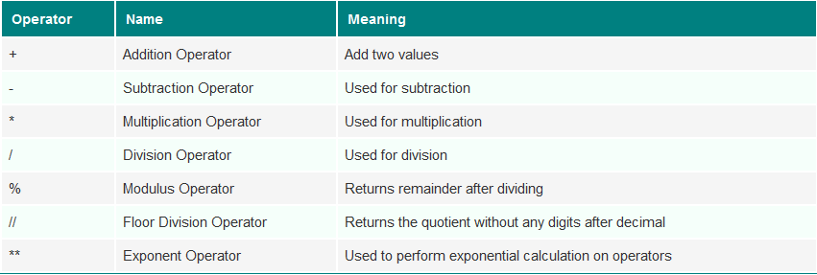
Arithmetic Operator

Slide 26
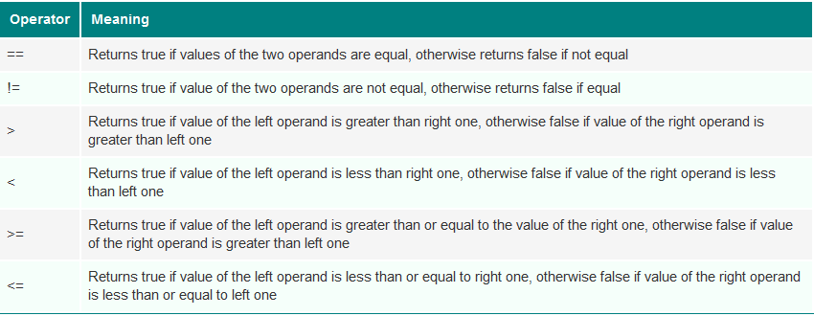
Comparison Operator

Slide 27
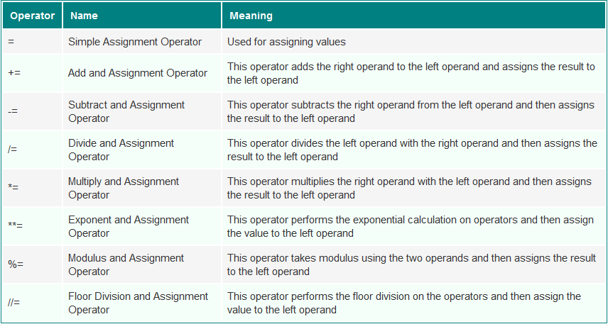
Assignment Operator

Slide 28
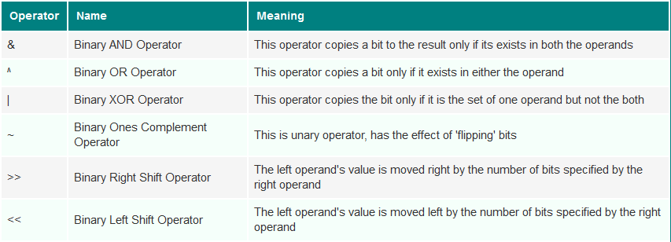
Bitwise Operator

Slide 29
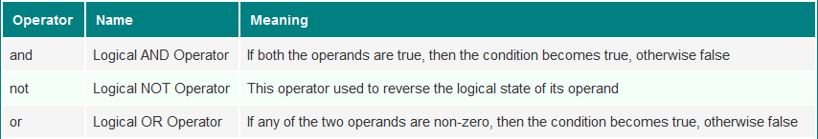
Logical Operator

Slide 30
Import statement
Usually, import statement in Python is the first statement or first line of the program.
The import statement is used to import or load modules (modules are files, contains code to be used in other program just by importing that module using the import statement), for example, to load random module, follow the below general form.
Syntax:
import random

Slide 31
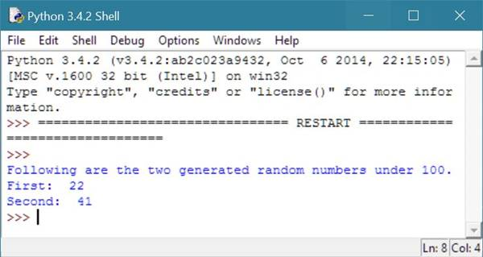
Import statement example
# Python import Statement Example
import random
val1 = random.randrange(100);
val2 = random.randrange(100);
print("Following are the two generated random numbers \ under 100.");
print("First: ",val1);
print("Second: ",val2);

Slide 32
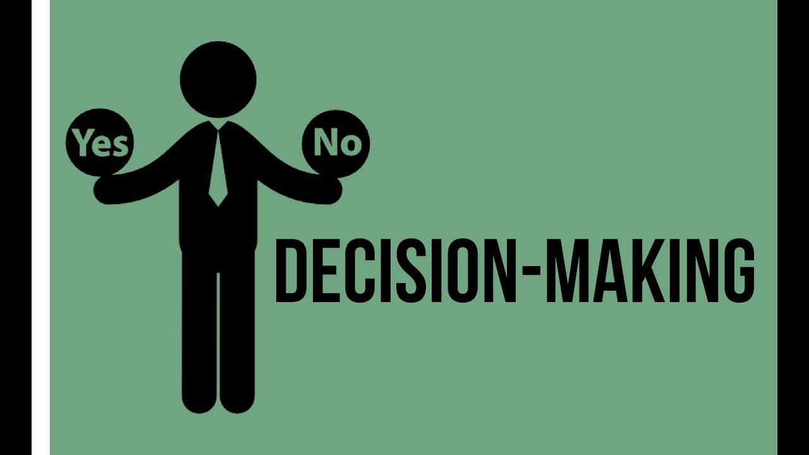
Decision Making
Decision making statements in python, helps in controlling your program accordingly.
If statement
If else statement
If elseif else statement
Nested if statement

Slide 33
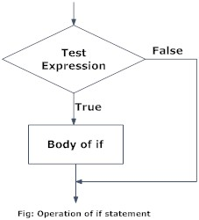
If statement
Decision making is required when we want to execute a code only if a certain condition is satisfied.
Syntax:
if test expression:
statement’s

Slide 34
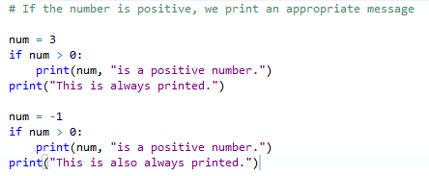

If statement example
Decision making is required when we want to execute a code only if a certain condition is satisfied.

Slide 35
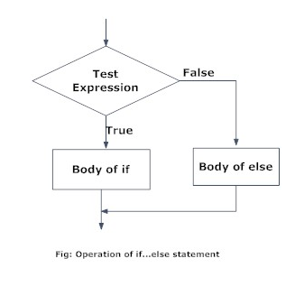
If… else statement
The if..else statement evaluates test expression and will execute body of if only when test condition is True.
If the condition is False, body of else is executed. Indentation is used to separate the blocks
Syntax:
if test expression:
Body of
if else:
Body of else

Slide 36
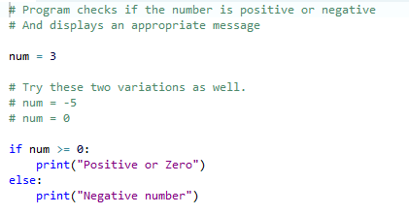
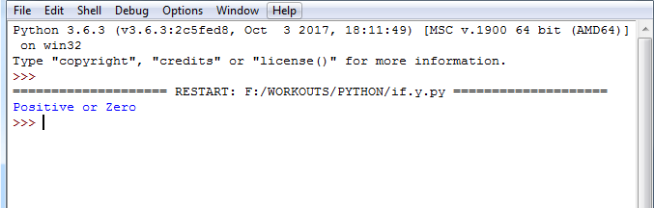
If… else statement example
Decision making is required when we want to execute a code only if a certain condition is satisfied.

Slide 37
If… elif… else statement
The elif is short for else if. It allows us to check for multiple expressions.
If the condition for if is False, it checks the condition of the next elif block and so on.
If all the conditions are False, body of else is executed.
Only one block among the several if...elif...else blocks is executed according to the condition.
The if block can have only one else block. But it can have multiple elif blocks.

Slide 38
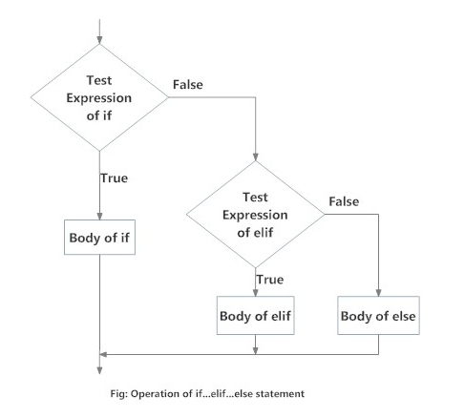
If… elif… else syntax
if test expression:
Body of if
elif test expression:
Body of elif
else:
Body of else

Slide 39
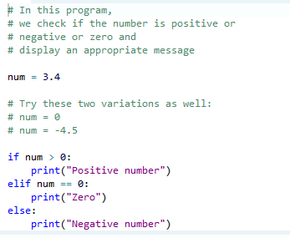
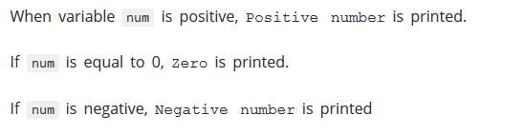
If… elif… else example

Slide 40
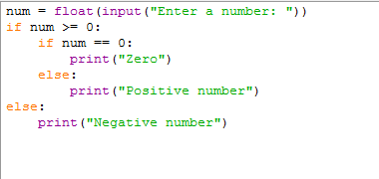
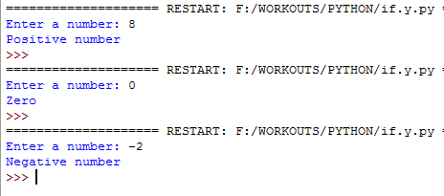
Nested if statement
We can have a if...elif...else statement inside another if...elif...else statement.
This is called nesting

Slide 41
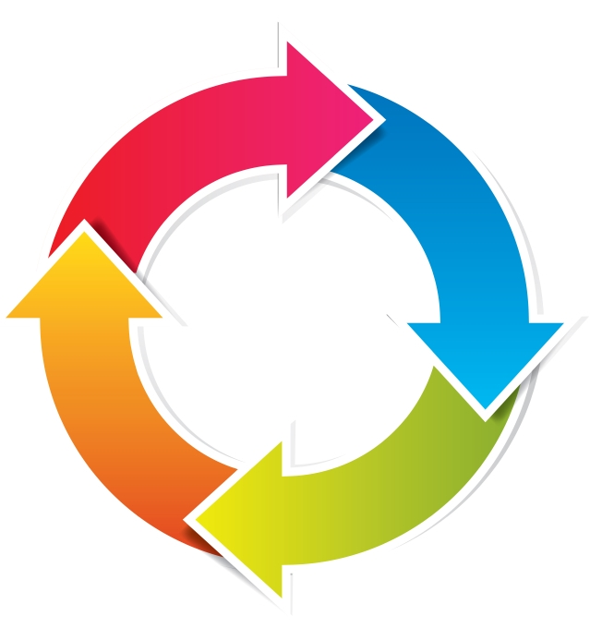
Loops
Loops are used to control your program.
Loops are basically used to execute a block of code several number of times accordingly.
There are the following types of loops:
For loop
While loop
Nested loop

Slide 42
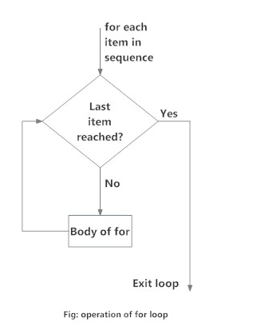
For loop
The for loop is used to iterate over a sequence (list, tuple, string)
Syntax:
for val in sequence:
Body of for

Slide 43
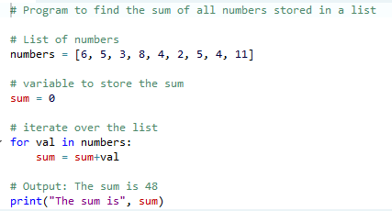
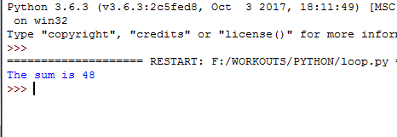
For loop example

Slide 44
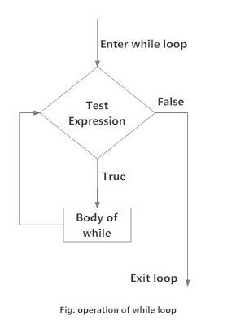
While loop
Python while loop generally used to perform the same action as for loop does, but in different way.
Syntax:
while expression:
statement(s)

Slide 45
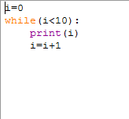
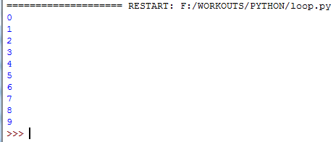
While loop example

Slide 46
Nested loop
Python programming language allows to use one loop inside another loop.
Nested for Syntax:
for iterating_var in sequence:
for iterating_var in sequence: statements(s)
statements(s)
Nested while Syntax:
while expression:
while expression:
statement(s)
statement(s)

Slide 47
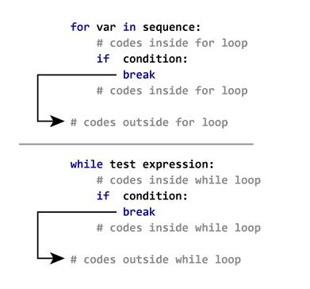
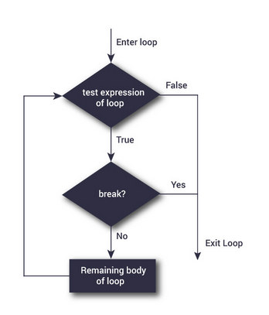
Break statement
The break statement is used to exit a loop.
Syntax:
break
break statement in for loop and while loop

Slide 48
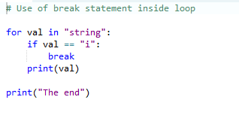
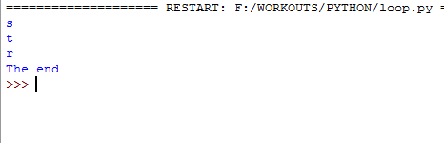
Break statement example

Slide 49
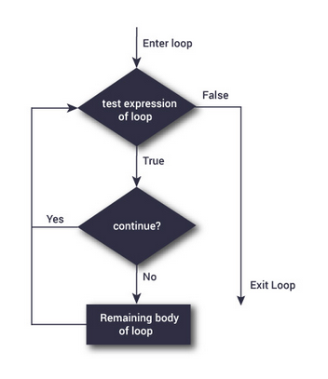
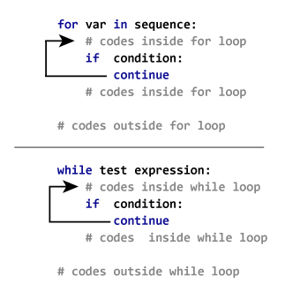
Continue statement
The continue statement is used to skip the rest of the code inside a loop for the current iteration only. Loop does not terminate but continues on with the next iteration.
Syntax:
continue
continue statement in for loop and while loop

Slide 50
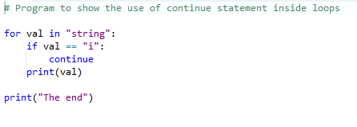
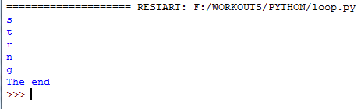
Continue statement example

Slide 51
Pass statement
The pass statement is a null operation;
nothing happens when it executes.
The pass is also useful in places where your code will eventually go, but has not been written yet
Syntax:
pass

Slide 52
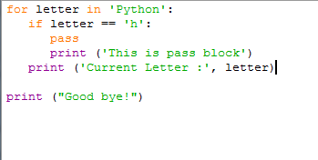
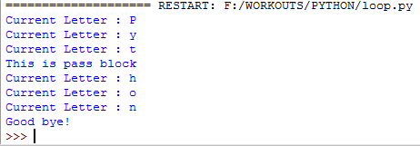
Pass statement example

Slide 53
Strings
A string is a sequence of characters.
A character is simply a symbol.
In Python, string is a sequence of Unicode character
Strings can be created by enclosing characters inside a single quote or double quotes
Syntax:
“ String “
‘ String ‘
“ Strings “
‘ Strings ‘

Slide 54
Strings
A string is a sequence of characters.
A character is simply a symbol.
In Python, string is a sequence of Unicode character
Strings can be created by enclosing characters inside a single quote or double quotes
Even triple quotes can be used in Python but generally used to represent multiline string.
How to create a string in Python?

Slide 55
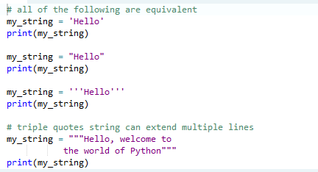
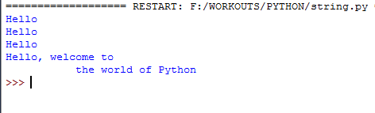
String Example

Slide 56
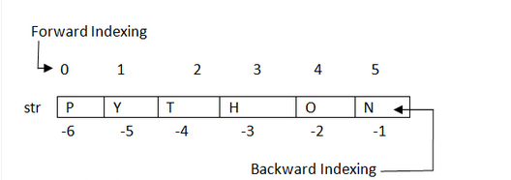
Accessing Python Strings
Strings are stored as individual characters in a contiguous memory location.
The benefit of using String is that it can be accessed from both the directions (forward and backward).
Forward indexing starts with 0,1,2,3,....
Backward indexing starts with -1,-2,-3,-4,....

Slide 57
String methods
Python has several built-in functions associated with the string data type.
These functions let us easily modify and manipulate strings.
Built-in functions are those that are defined and are readily available for us to use.
Types of string functions
capitalize()
upper()
index()
……so on……………………….

Slide 58
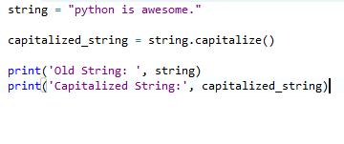

capitalize()
The capitalize() function returns a string with first letter capitalized.
It doesn't modify the old string.
Syntax:
string.capitalize()

Slide 59


upper()
It returns the uppercased string from the given string.
It converts all lowercase characters to uppercase.
If no lowercase characters exist, it returns the original string.
Syntax:
string.upper()

Slide 60


index()
If substring exists inside the string, it returns the lowest index in the string where substring is found.
If substring doesn't exist inside the string, it raises a ValueError exception.
Syntax:
string.index(substring)

Slide 61
Lists
Lists in python are also a type of sequences just like tuples.
Unlike tuples, lists are mutable, that is, lists can be modified. Therefore, lists have all the features that tuples have, plus another feature is, it can be modified.
A list basically contains items separated by commas and enclosed within the square brackets [].
Items in the list needn't be of the same type.

Slide 62
Lists Syntax
# empty list
my_list = []
# list of integers
my_list = [1, 2, 3]
# list with mixed datatypes
my_list = [1, "Hello", 3.4]
Nested list
# nested list
my_list = ["mouse", [8, 4, 6], ['a']]

Slide 63


Lists Examples

Slide 64


Slice the lists
We can access a range of items in a list by using the slicing operator (colon).

Slide 65


Change element to a list
We can access a range of items in a list by using the slicing operator (colon).

Slide 66


Insert element to a list
we can insert one item at a desired location by using the method insert()

Slide 67
Tuples
A tuple is similar to a list.
The difference between the two is that we cannot change the elements of a tuple once it is assigned whereas in a list, elements can be changed.
tup1 = ('physics', 'chemistry', 1997, 2000);
tup2 = (1, 2, 3, 4, 5 );
tup3 = ("a", "b", "c", "d");

Slide 68


Accessing elements in a tuple
1. Indexing

Slide 69


2. Negative indexing

Slide 70


3. Slicing

Slide 71
Dictionary
Dictionary in python is same as real life dictionary book, as in dictionary, you can store your information in the form of key-value pair.
Here key represent the word (the dictionary word) and value is its definition just like the definition in dictionary book.
Using dictionary in python, you can organize your information.
Syntax:
my_dictionary = {'Name': ‘Elysium ','Id':9388, 'Branch': 'CSE'};

Slide 72


Access elements from a dictionary?
Key can be used either inside square brackets or with the get() method.
The difference while using get() is that it returns None instead of KeyError,
if the key is not found.

Slide 73


Change or add elements in a dictionary
Dictionary are mutable.
We can add new items or change the value of existing items
using assignment operator.
If the key is already present, value gets updated,
else a new key: value pair is added to the dictionary.

Slide 74
Functions
A function in python, is a block of code, used to perform a particular action.
Rules to define a function
It begins with the keyword def, followed by the function name and then parentheses.
the parameters/arguments should be placed inside these parentheses
the code block of the function starts with a colon (:)
and now the return statement exits a function, passing back an expression to the function caller
a return statement with no any arguments is the same as return None

Slide 75


Syntax of function
def function_name(parameters):
"""docstring"""
statement(s)

Slide 76
return statement
The return statement is used to exit a function and go back to the place from
where it was called.
Syntax:
return [expression_list]
This statement can contain expression which gets evaluated and the value is
returned.
If there is no expression in the statement or the return statement itself
is not present inside a function, then the function will return the None object.

Slide 77

PyCharm installation
Windows
Installing PyCharm on Windows is very simple. To install PyCharm on Windows operating system, visit the link https://www.jetbrains.com/pycharm/download/download-thanks.html?platform=windows to download the executable installer. Double click the installer (.exe) file and install PyCharm by clicking next at each step.
To create a first program to Pycharm follows the following step.
Step - 1. Open Pycharm editor. Click on "Create New Project" option to create new project.

Slide 78

PyCharm installation
Step - 2. Select a location to save the project.

Slide 79
PyCharm installation
Step - 2. Select a location to save the project.
We can save the newly created project at desired memory location or can keep file location as it is but atleast change the project default name untitled to "FirstProject" or something meaningful.
Pycharm automatically found the installed Python interpreter.
After change the name click on the "Create" Button.
Step - 3. Click on "File" menu and select "New". By clicking "New" option it will show various file formats. Select the "Python File".
Step - 4. Now type the name of the Python file and click on "OK". We have written the "FirstProgram".

